Slide 1
Programming Data Visualizations that Show Change Over Time
Module: 2 – Change Over Time – The Code
DVP
CS4 Continued

Slide 2
Activity - Experiment with R and Python Code for DVP to Show How Data Change Over Time
PPTX Companion to CS4 video called:

Slide 3


Data Visualizations - Change Over Time
How to program data visualizations that show change over time in Python.
How to program data visualization that show change over time in R.

Slide 4
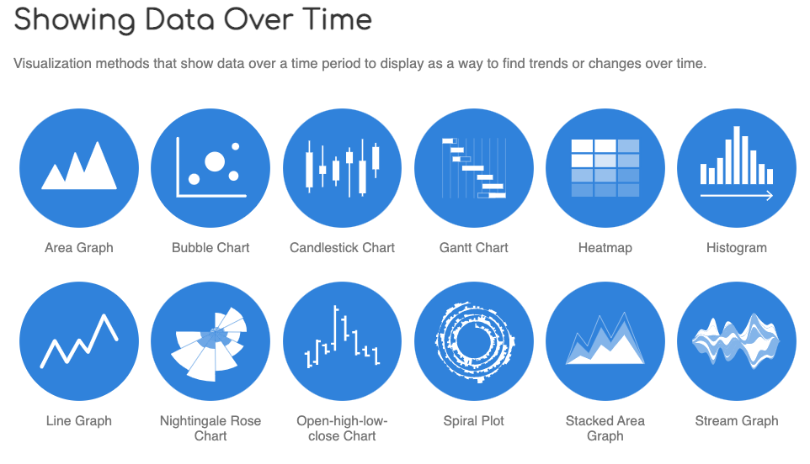
Notes:
Source:
https://datavizcatalogue.com/search/time.html

Slide 5
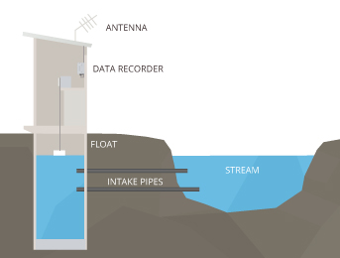
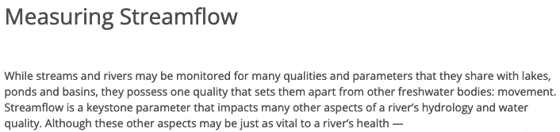
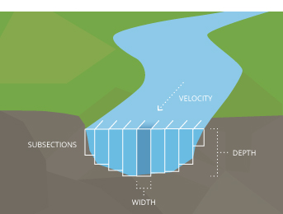
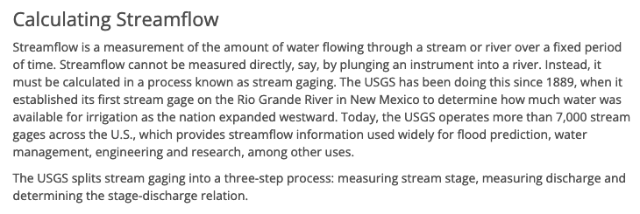
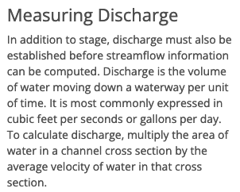
Class Session 4 Activity Datasets
Get two files (csv and xlsx) from the Class Session 4 Bb folder.
Notes:
Information Source: https://www.fondriest.com/environmental-measurements/measurements/hydrological-measurements/streamflow-measurements/
Data Source:
https://serc.carleton.edu/hydromodules/steps/td1.html

Slide 6

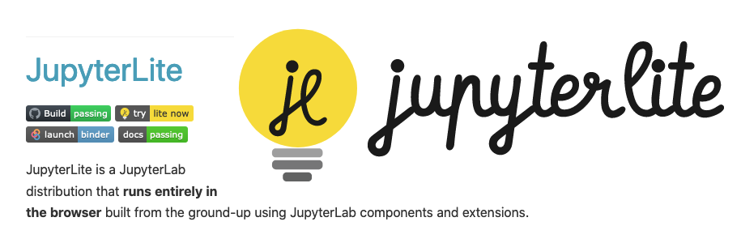
Our process for programming data visualizations in Python.
Create Python notebook (.ipynb)
Insert code and documentation lines and optimize them as we go along
Import libraries (install items as needed)
Import data
Explore the data
Do some data processing
Define variables
Create additional variables if needed
Create data visualizations (DVs)
Save DVs as stand-alone image files
Insert DVs into a report document and write data insights
Download completed Python notebook
Students in this course are required to do Python exercises in the JupyterLite web-based environment:
https://jupyter.org/try-jupyter/lab/
Notes:
Go to our Python web-based development environment:
https://jupyter.org/try-jupyter/lab/

Slide 7
At this point,
locate the .ipynb codebook that you created as a result of engaging in the previous Class Session 3 activity that Dr. Mead called, "Class_Session_3_Activity-DVP-LS24.ipynb" in her demonstration contained in the CS3 video called, "Activity - Experiment with Some Basic R and Python Code for DVP", then
follow what Dr. Mead demonstrates to do next after this slide point in the CS4 video, "Activity - Experiment with R and Python Code for DVP to Show How Data Change Over Time".

Slide 8
Streamflow change over time CSV in Python
# Create a basic line chart that shows change over time in python using a CSV file.
# Dataset source: https://serc.carleton.edu/hydromodules/steps/td1.html
# The data used in this Activity are Streamflow in cubic feet per second
import pandas as pd
import numpy as np
import matplotlib.pyplot as plt
df1 = pd.read_csv("Class_Session_4_Activity.csv")
df1.head()
df1.columns
df1.describe()
x1 = df1["Date"]
x1
y1 = df1["Streamflow"]
y1
plt.plot(x1, y1)
plt.xticks(x[::365], rotation=25) # To make the x axis include all the dates that we have, and to rotate them to fit.
plt.ylabel("Streamflow (cfs)") # “cfs” is one way to abbreviate "cubic feet per second"
plt.title("Streamflow Over Time")
plt.savefig("Streamflow-CSV-Python.png") # To save the Python DV to a file. Change it to .jpg if you want a .jpg
plt.plot
# Experiment with ways to customize your Python Line Chart DV here: https://www.python-graph-gallery.com/line-chart/
P1
Students in this course are required to do Python exercises in the JupyterLite web-based environment:
https://jupyter.org/try-jupyter/lab/

Slide 9
Streamflow change over time XLSX in Python
# Create a basic line chart that shows change over time in python using an XLSX file.
import piplite
await piplite.install("openpyxl")
df2 = pd.read_excel("Class_Session_4_Activity.xlsx")
df2.head()
df2.columns
df2.describe()
x2 = df2["Date"]
x2
y2 = df2["Streamflow"]
y2
plt.plot(x2, y2)
plt.xticks(x[::365], rotation=25) # To make the x axis include all the dates that we have, and to rotate them to fit.
plt.ylabel("Streamflow (cfs)") # “cfs” is one way to abbreviate “cubic feet per second”
plt.title("Streamflow Over Time")
plt.savefig("Streamflow-XLSX-Python.png") # To save the Python DV to a file. Change it to .jpg if you want a .jpg
plt.plot
# Experiment with ways to customize your Python Line Chart DV here: https://www.python-graph-gallery.com/line-chart/
P2
Students in this course are required to do Python exercises in the JupyterLite web-based environment:
https://jupyter.org/try-jupyter/lab/

Slide 10
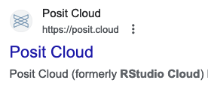
Our process for programming data visualizations in R.
Create an R Markdown document (.Rmd) "R codebook"
Insert code and documentation lines and optimize them as we go along
Install packages if required
Load libraries
Import data
Explore the data
Do some data processing
Define variables
Create additional variables if needed
Create data visualizations (DVs)
Save DVs as stand-alone image files
Insert DVs into a report document and write data insights
Download completed R codebook
Students in this course are required to do R exercises in the RStudio Cloud web-based environment:
https://login.rstudio.cloud/login?redirect=%2F

Slide 11
Streamflow change over time CSV in R
R1
# Create a basic line chart that shows change over time in R using an CSV file.
# Dataset source: https://serc.carleton.edu/hydromodules/steps/td1.html
# The data used in this Activity are Streamflow in cubic feet per second
if(!require("ggplot2")) install.packages("ggplot2")
if(!require("dplyr")) install.packages("dplyr")
library(ggplot2)
library(dplyr)
data1 <- read.csv("Class_Session_4_Activity.csv")
data1$Date = as.Date(data1$Date, "%m/%d/%y") # To make sure the Date column is in the format that we want.
head(data1)
names(data1)
summary(data1)
sapply(data1, sd)
# Assign it to a variable and create the DV
g1 <- ggplot(data1, aes(Date, Streamflow)) + geom_line(color = "blue") + scale_y_continuous("Streamflow (cfs)") + ggtitle("Streamflow Over Time") + ylab("Streamflow (cfs)") + scale_x_date(date_labels = "%m/%d/%Y") + theme(plot.title=element_text(hjust=0.5), axis.title.x = element_blank(), panel.grid.major = element_blank(), panel.grid.minor = element_blank(), panel.background = element_blank(), axis.text.x = element_text(angle=45))
g1 # To show the DV on the screen
ggsave("streamflow-CSV-R.jpeg") # To save the R DV to a file. Change it to .jpg if you want a .jpg
# Experiment with ways to customize your R Line Chart DV here: https://r-graph-gallery.com/line-plot.html
Students in this course are required to do R exercises in the RStudio Cloud web-based environment:
https://login.rstudio.cloud/login?redirect=%2F

Slide 12
Streamflow change over time XLSX in R
R2
# Create a basic line chart that shows change over time in R using an XLSX file.
if(!require("readxl")) install.packages("readxl")
library(readxl)
data2 <- read_excel("Class_Session_4_Activity.xlsx")
data2$Date = as.Date(data22$Date, "%m/%d/%y") # To make sure the Date column is in the format that we want.
head(data2)
names(data2)
summary(data2)
sapply(data2, sd)
# Assign it to a variable and create the DV
g2 <- ggplot(data2, aes(Date, Streamflow)) + geom_line(color = "blue") + scale_y_continuous("Streamflow (cfs)") + ggtitle("Streamflow Over Time") + ylab("Streamflow (cfs)") + scale_x_date(date_labels = "%m/%d/%Y") + theme(plot.title=element_text(hjust=0.5), axis.title.x = element_blank(), panel.grid.major = element_blank(), panel.grid.minor = element_blank(), panel.background = element_blank(), axis.text.x = element_text(angle=45))
g2 # To show the DV on the screen
ggsave("streamflow-XLSX-R.jpeg") # To save the R DV to a file. Change it to .jpg if you want a .jpg
# Experiment with ways to customize your R Line Chart DV here: https://r-graph-gallery.com/line-plot.html
Students in this course are required to do R exercises in the RStudio Cloud web-based environment:
https://login.rstudio.cloud/login?redirect=%2F

Slide 13
End of file.

